Slide 2
IDPs For The Rest of Us: Maximizing Impact When You Aren’t a Tech Giant
Eric Irwin | Sr. Director of Engineering at Quantum Metric

Slide 3
Agenda
Background and Context
Feature Spotlights
Key Themes and Takeaways

Slide 4

About Me (and our Team)
Currently lead Platform Delivery team
Working with Backstage for 3 years now.
Not active Backstage contributor, but did fix a typo in the documentation once.
Eric Irwin
Sr. Director of Engineering Quantum Metric

Slide 5

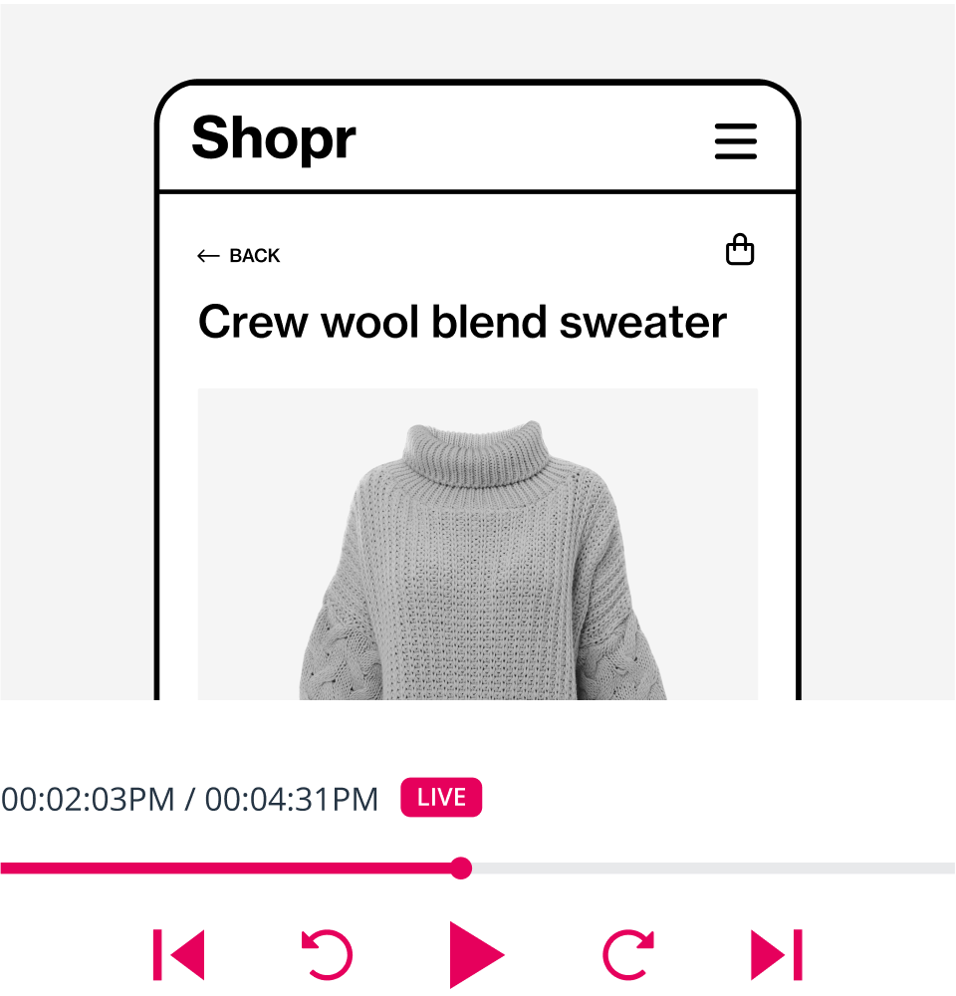
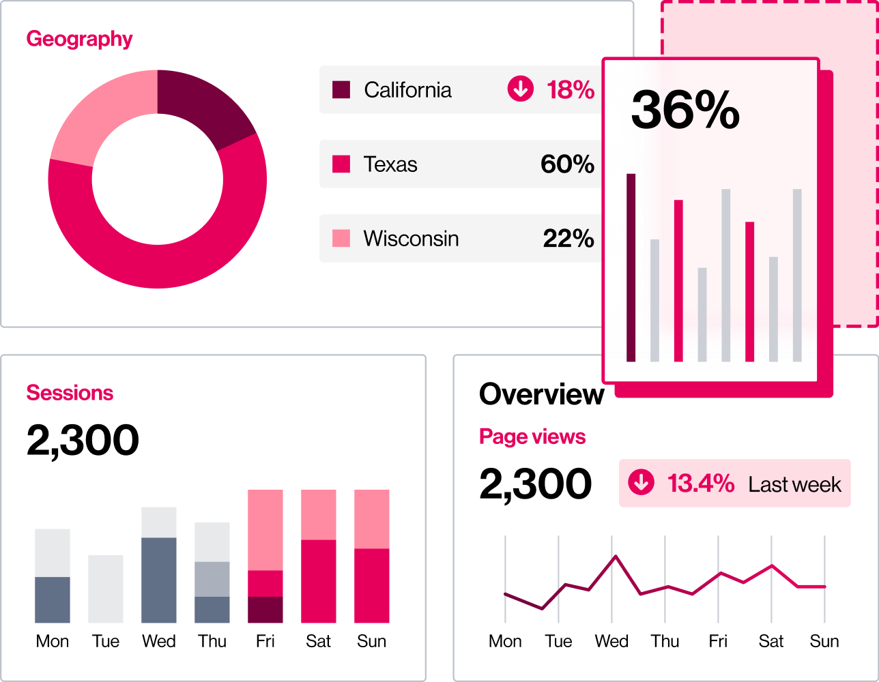
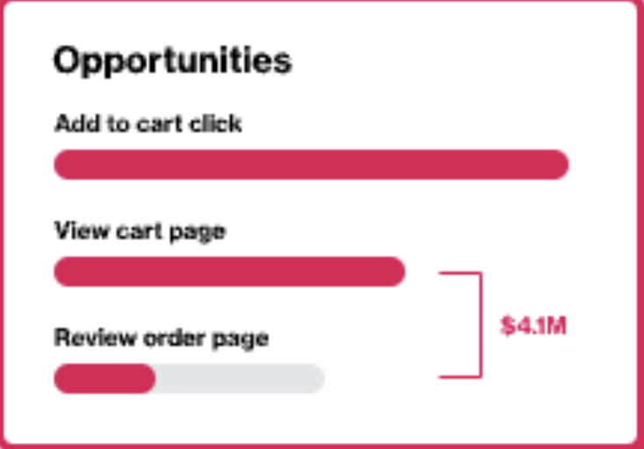
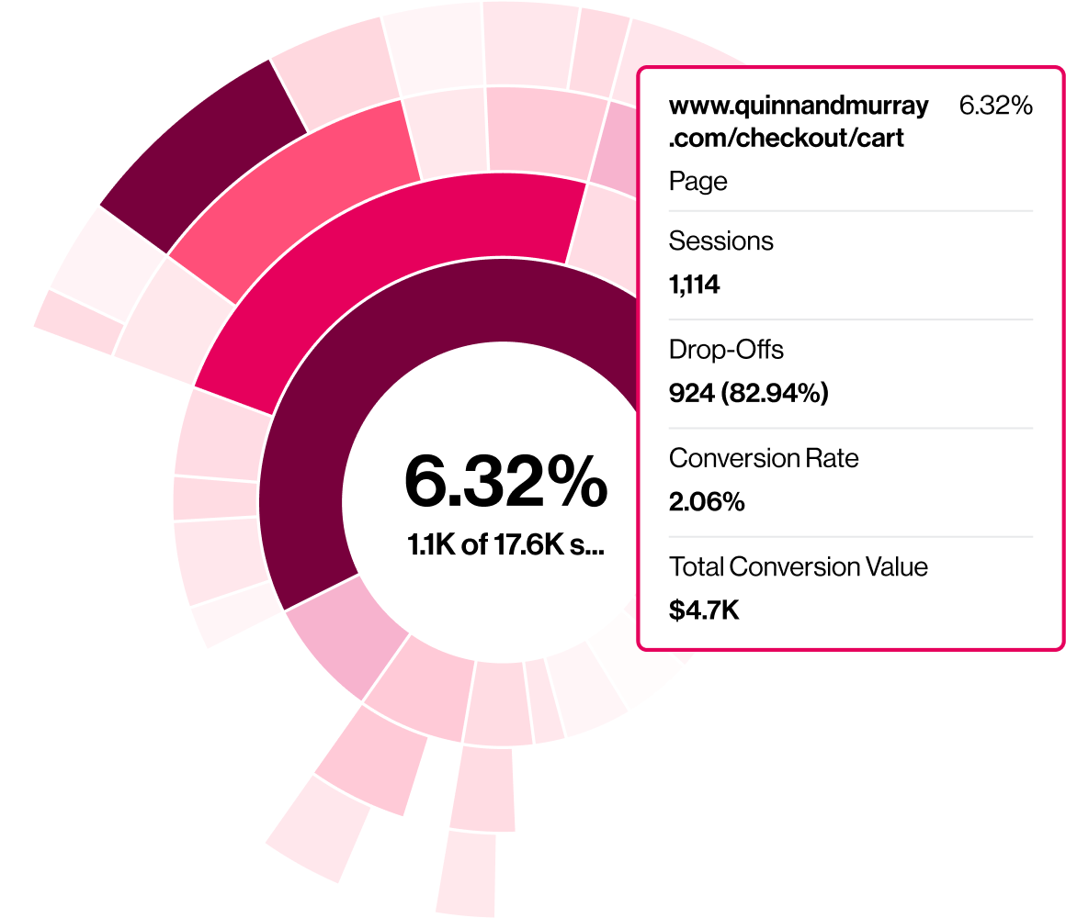
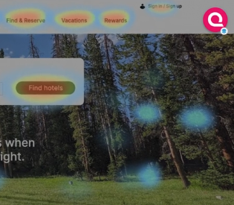
About Quantum Metric
Quantum Metric helps organizations understand customer needs in real time, quantify impact, and prioritize what matters most to their business.
Real Time
Session Replay
Monitoring and Alerting
Opportunity Analysis
Journey
Analysis
Interactions and Heatmaps
Identify ➜ Quantify ➜ Prioritize ➜ Measure

Slide 6
Small But Mighty
Quantum Metric is expected to process 70 Billion sessions in 2024!
~6B
sessions each
month.
~65
Operations and Engineering

Slide 7
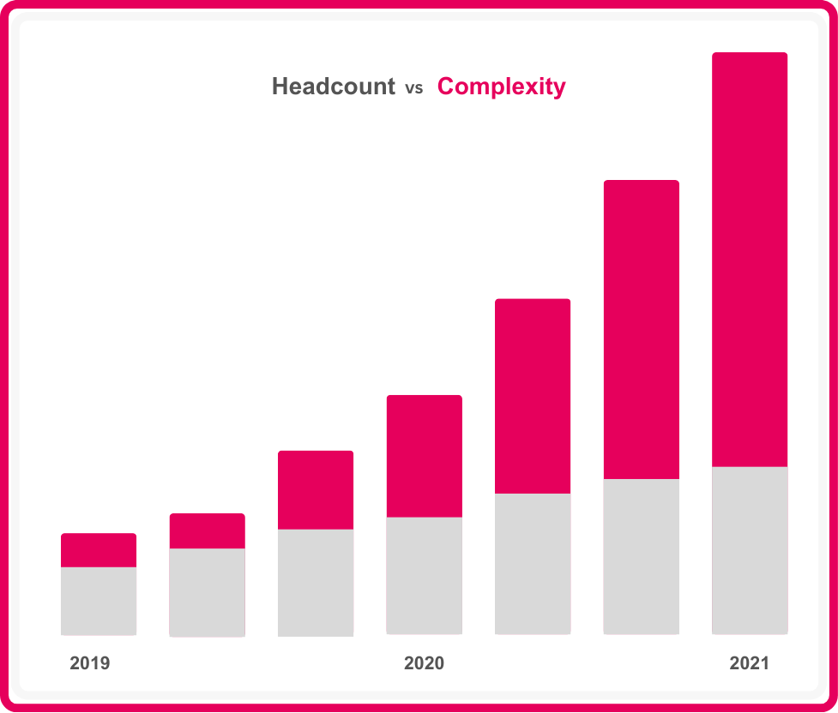
Quantum Metric - Scale and Complexity
Increasing demands and challenges due to customer growth
Increasing volume of data ingested
Overall complexity of our platform increased

Slide 8
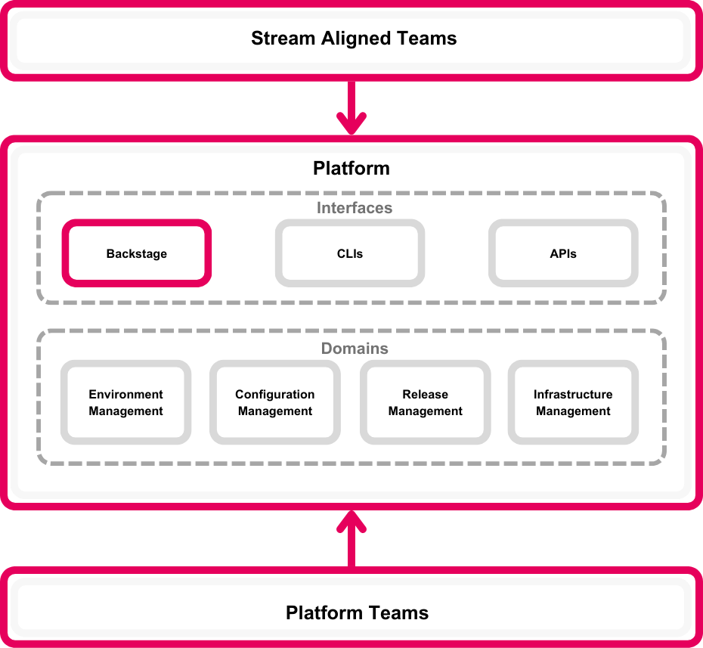
Rethinking our Platform Strategy
Shifting away from Enablement towards a Platform and Product Mindset
Emphasis on using data to measure, iterate and validate what we were building.
Backstage provided the connective fabric in the early days of our platform.

Slide 9
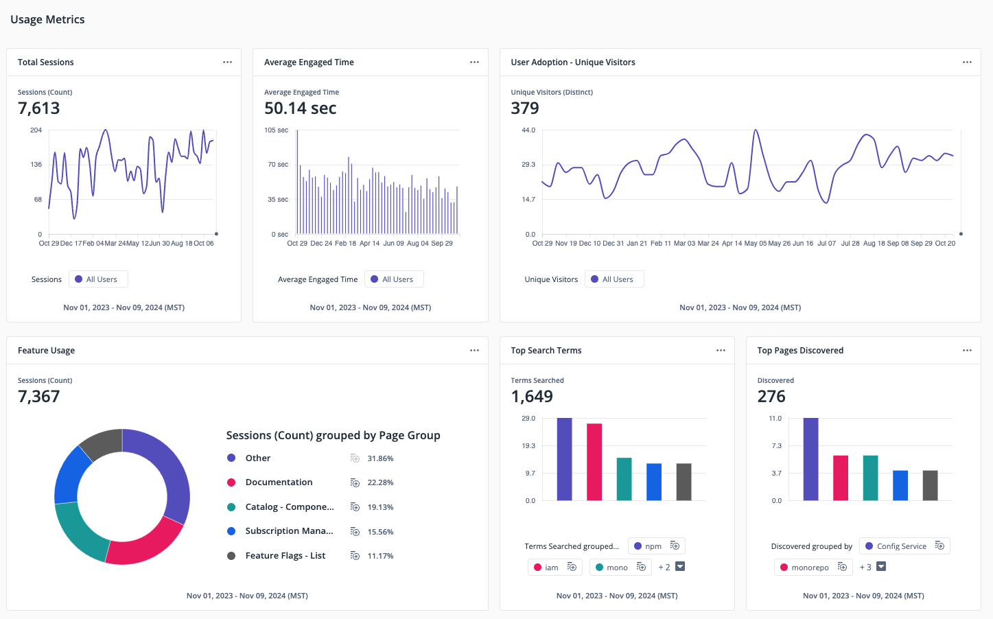
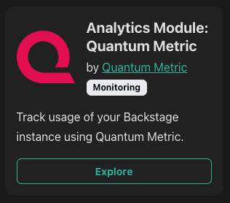
Backstage Analytics
Capturing usage and engagement metrics and events through Backstage Analytics using Quantum Metric

Slide 10
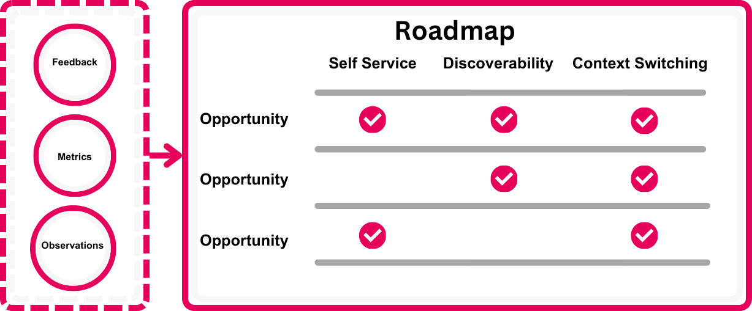
Turning Challenges into Opportunities
Confidence in the roadmap starts with anchoring on Feedback, Metrics, and Observations

Slide 11
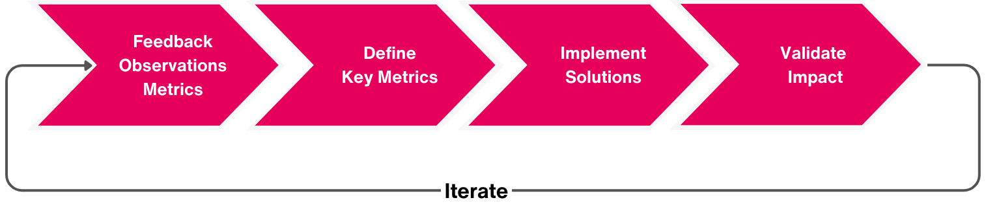
Feature Spotlights
A feedback-informed cycle ensures every step, from implementation to validation, contributes to measurable impact and value.

Slide 12
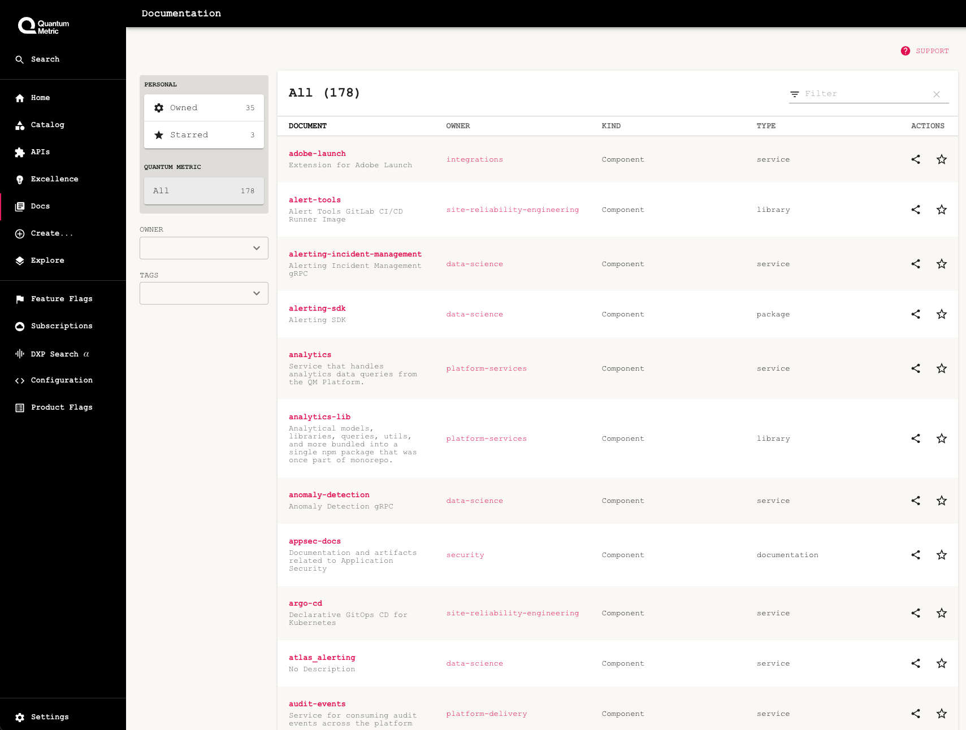
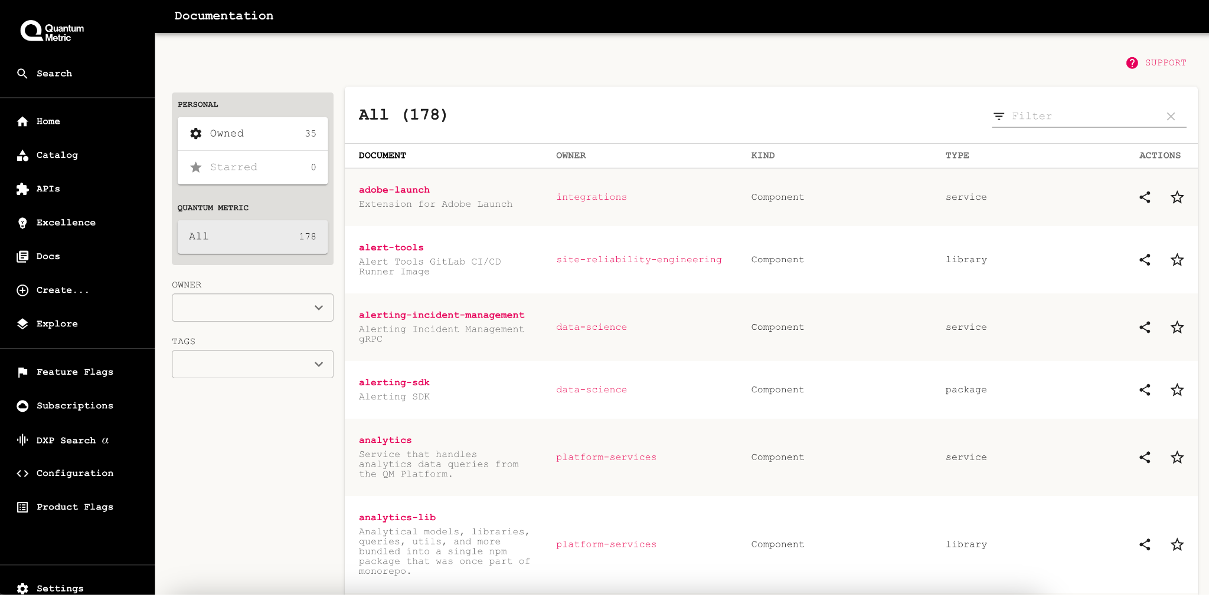
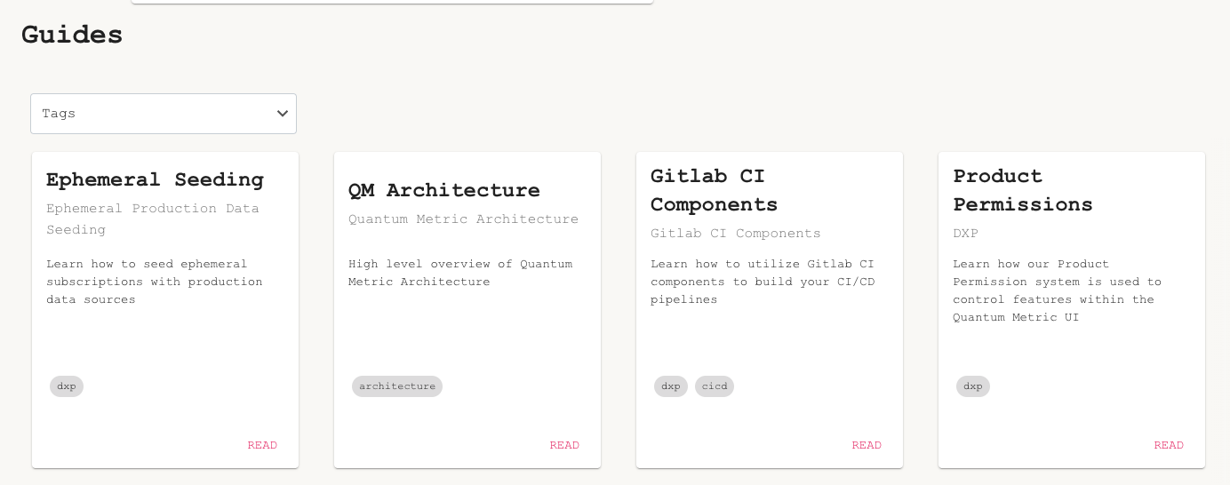
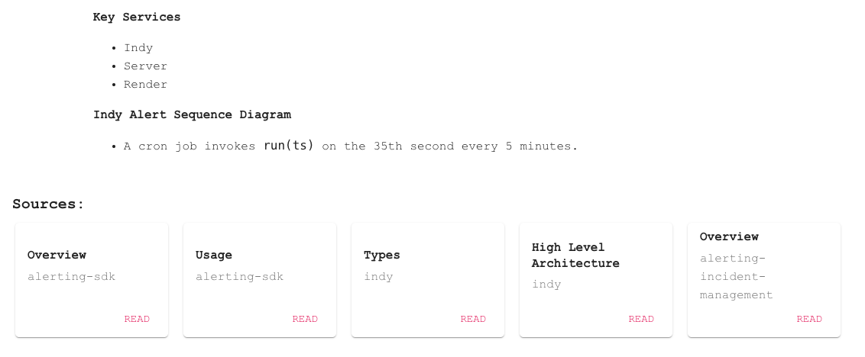
Documentation
Goal: Increase quality and discoverability of documentation
Guided Access
Improved Search

Slide 13
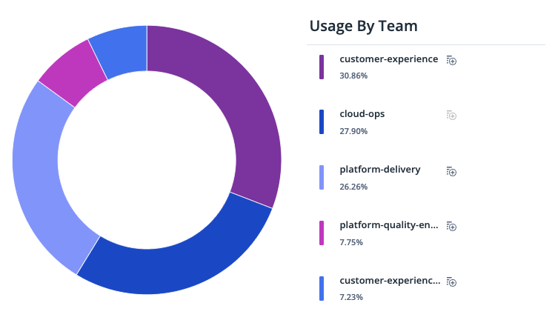
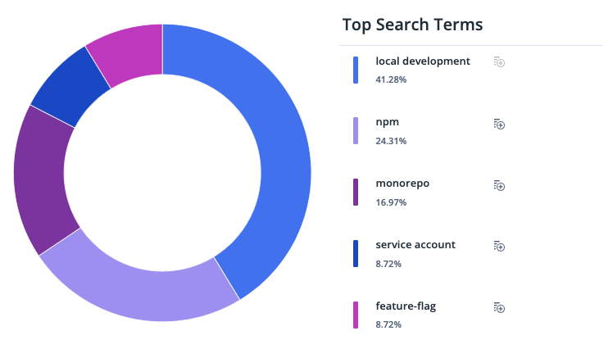
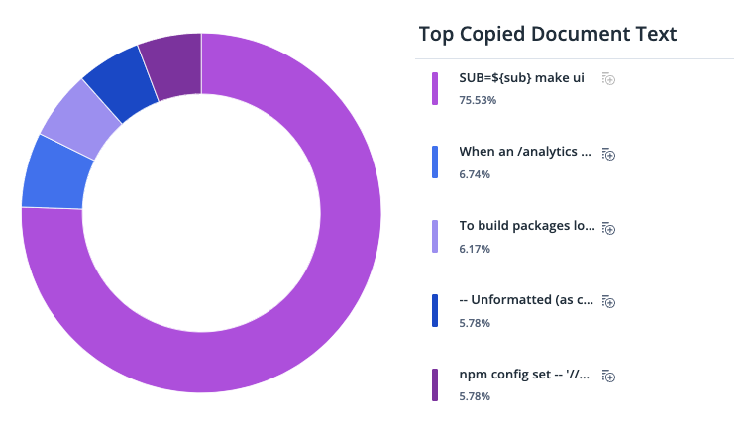
Documentation
How do we validate impact?
Team Usage
Search Engagement
Documentation Engagement
Docs Per Team
Contribution Rate
Usage By Team
Search Hit Rate
Top Search Terms
Total Search Usage
Engagement Time
Top Copied Text
Top Docs Viewed

Slide 14
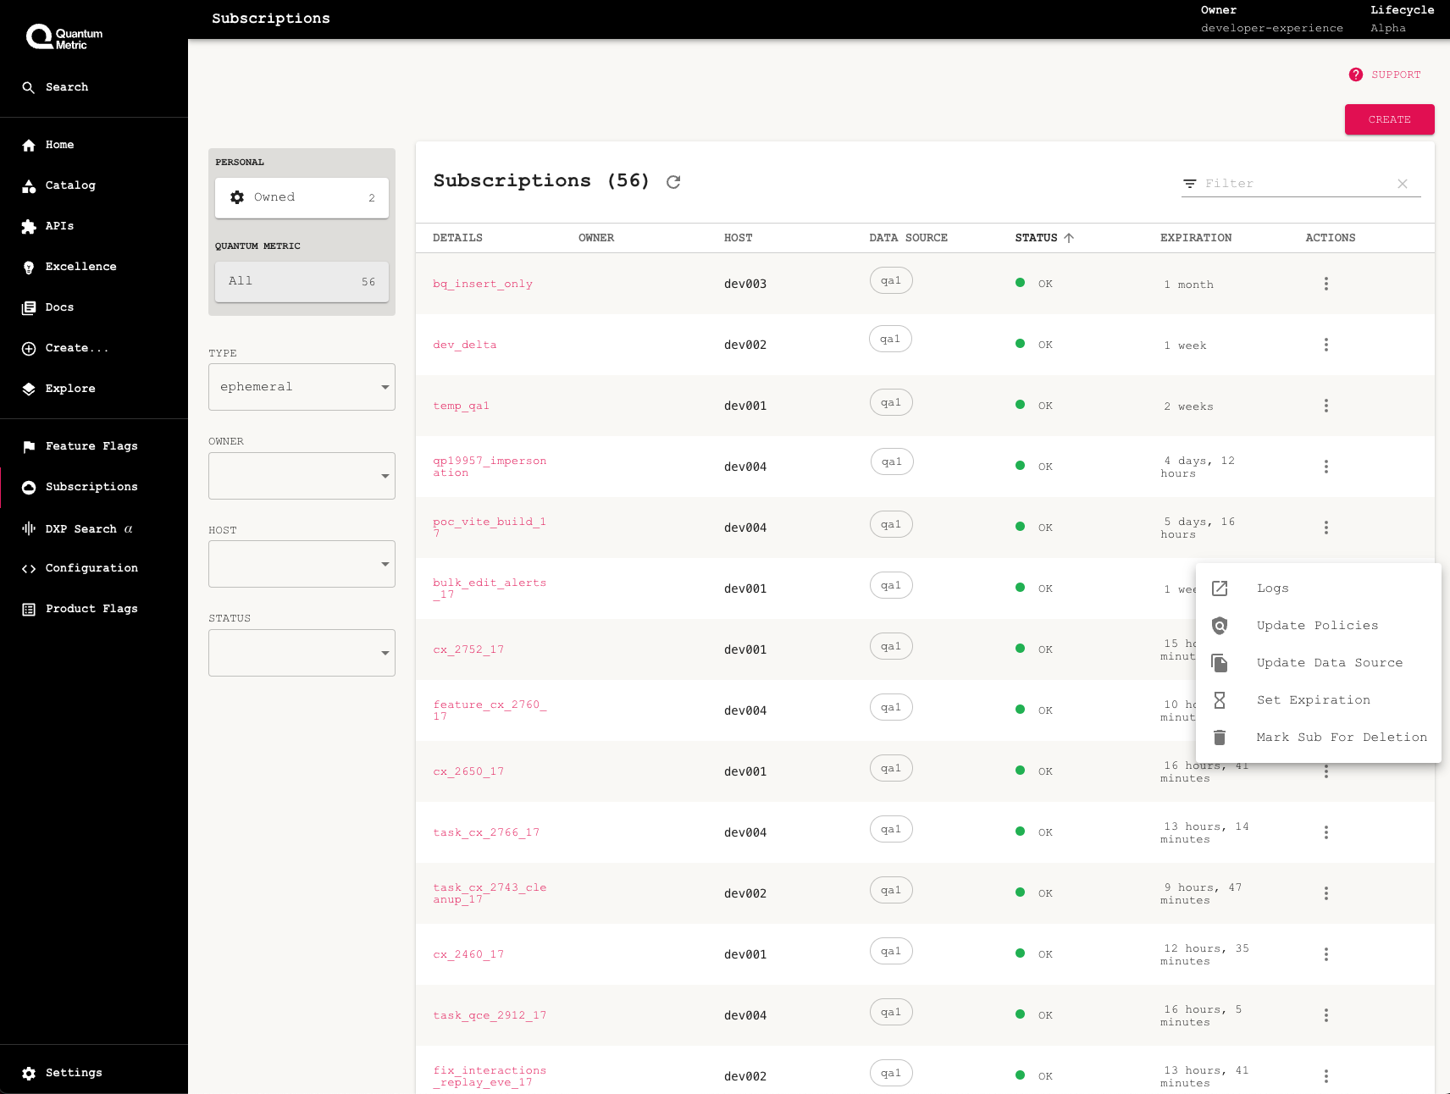
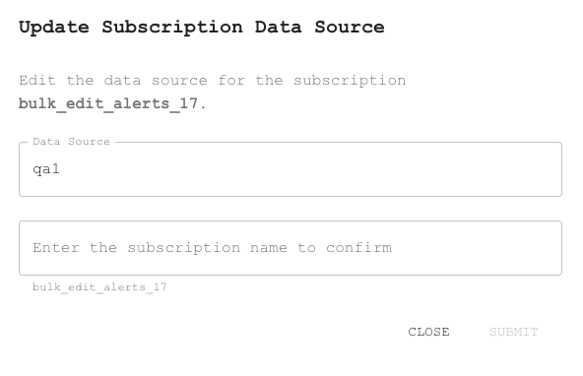
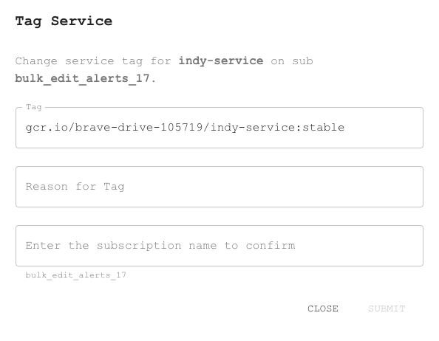
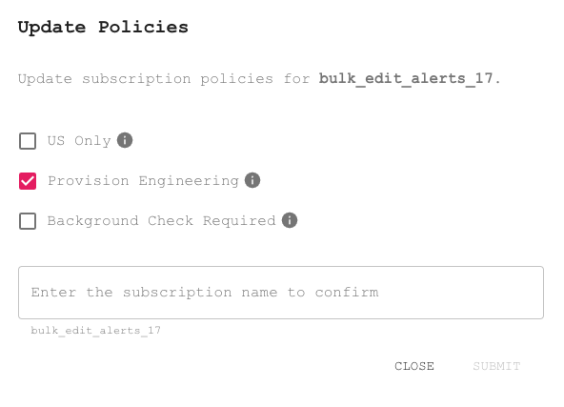
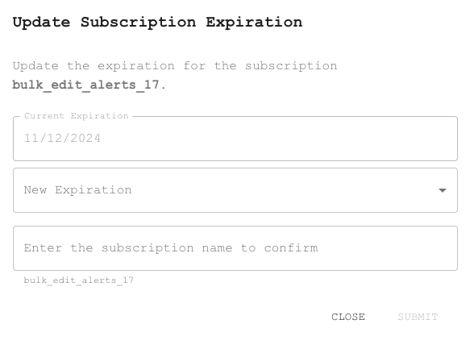
Ephemeral Environments
Goal: Increase self-service and reduce context switching
Self Service Configuration
Governance and Accountability

Slide 15
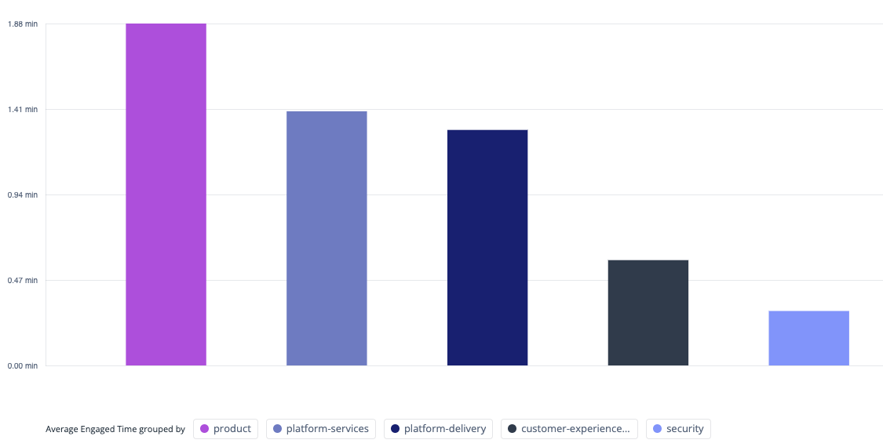
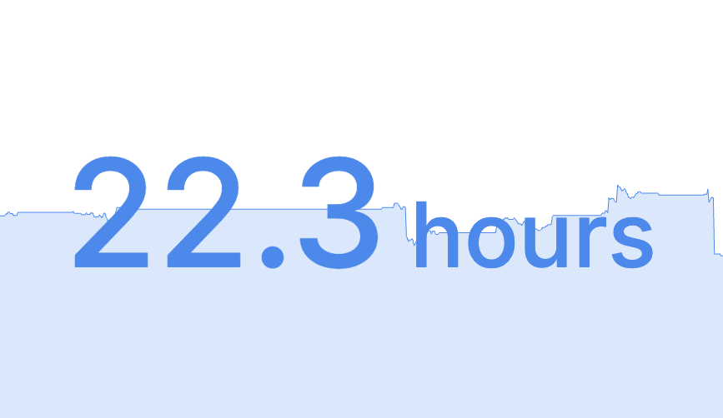
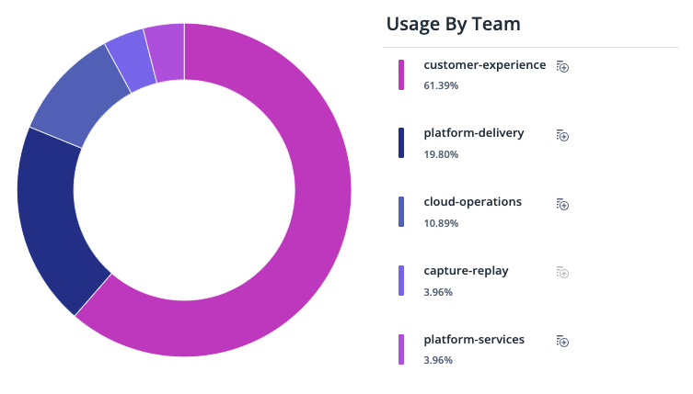
Ephemeral Subscriptions
How do we validate impact?
Overall Engagement
Velocity
Usage By Team
Total Engaged Time
Creation Rate
Average Lifetime
Cycle Time
Open MR Rate
MR Lifetime
Per Team Total
Weekly Team Usage
Usage Behaviors

Slide 16
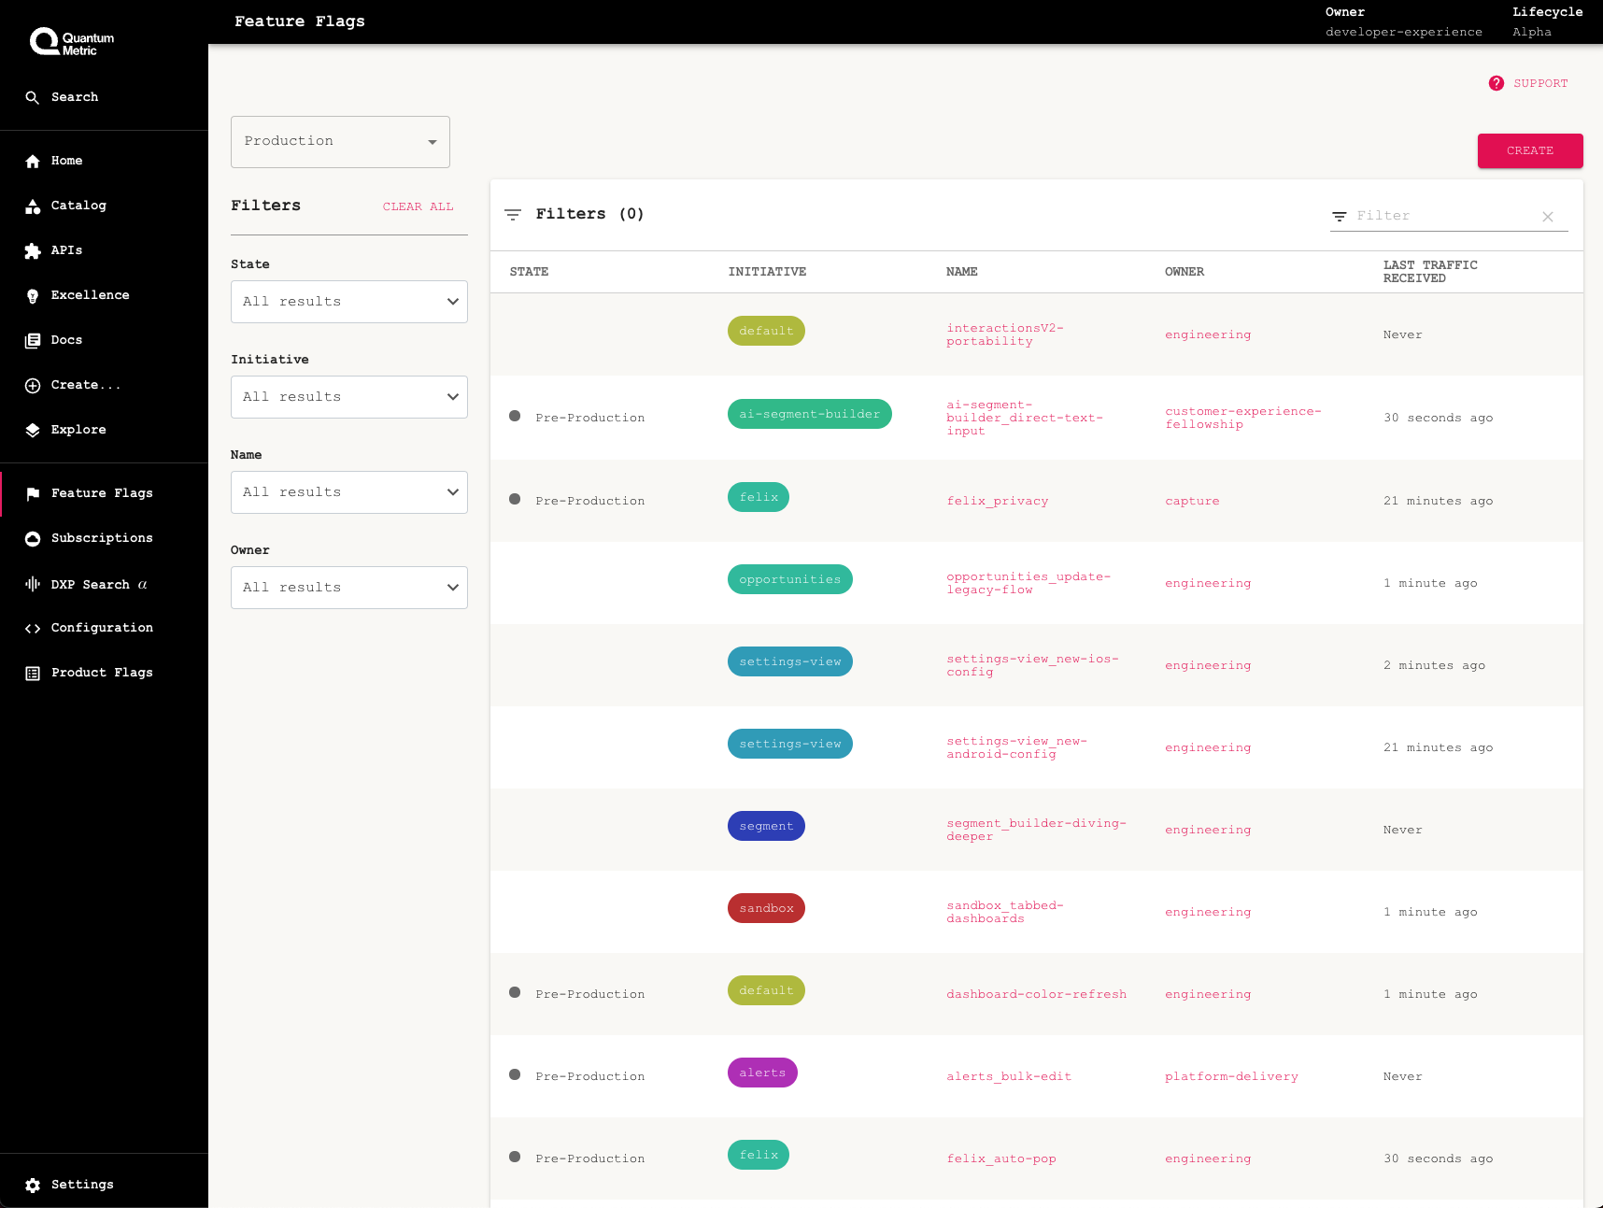
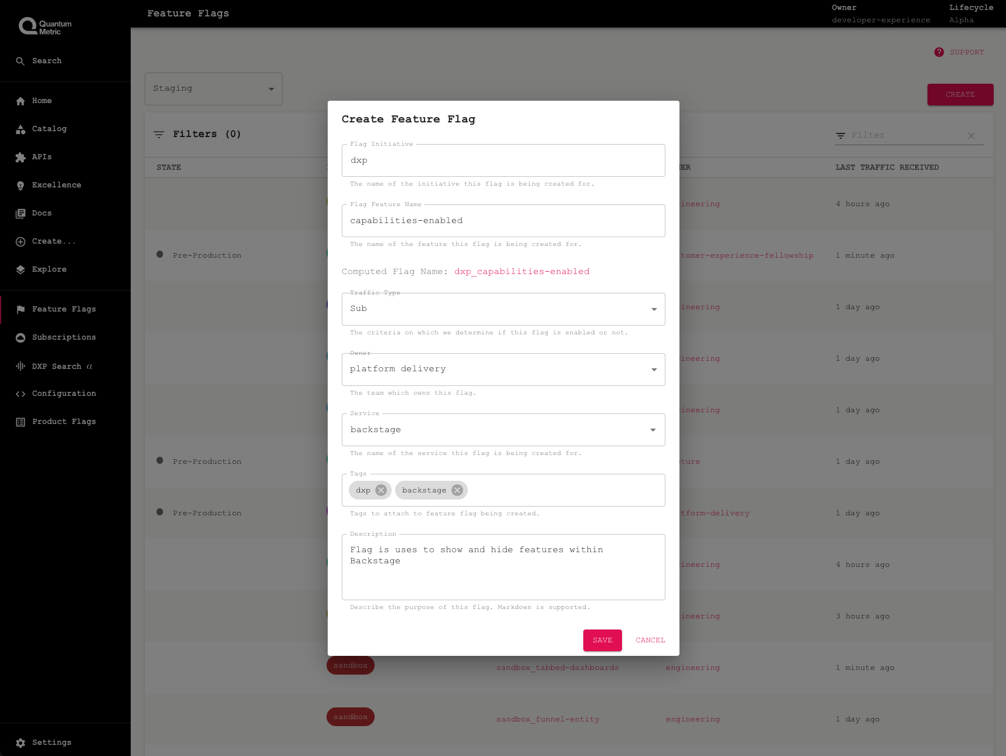
Feature Flags
Goal: Increase adoption and standardization of feature flags

Slide 17
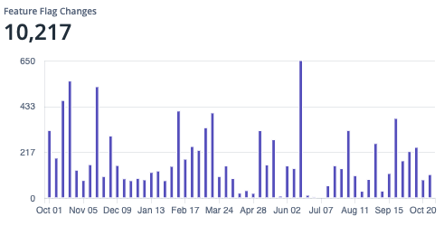
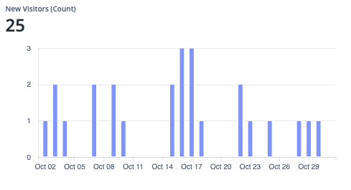
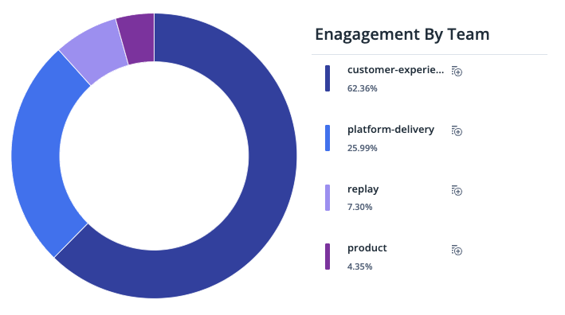
Feature Flags
Key Metrics: Feature Flag Adoption and Creation Rate, Engagement
Overall Usage
Adoption
Team Usage
Flag Creation Rate
Flag Change Rate
Feature Usage
Unique Users
Role and Team Adoption
Total Flags Per Team
Team Engagement and Usage

Slide 18
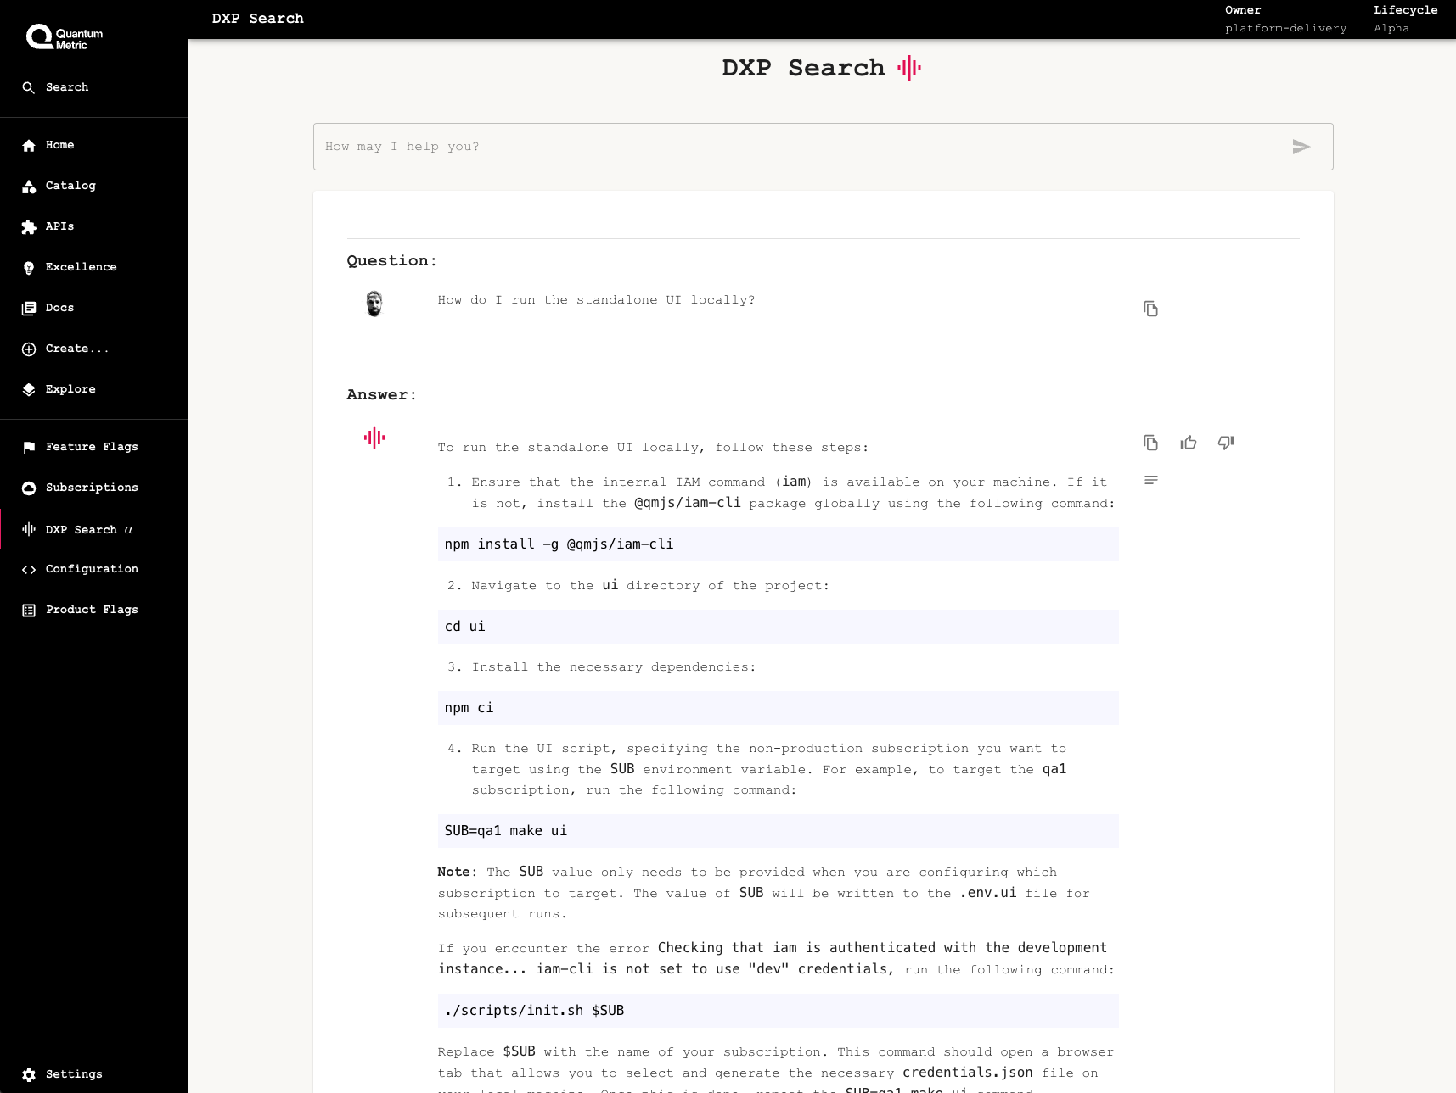
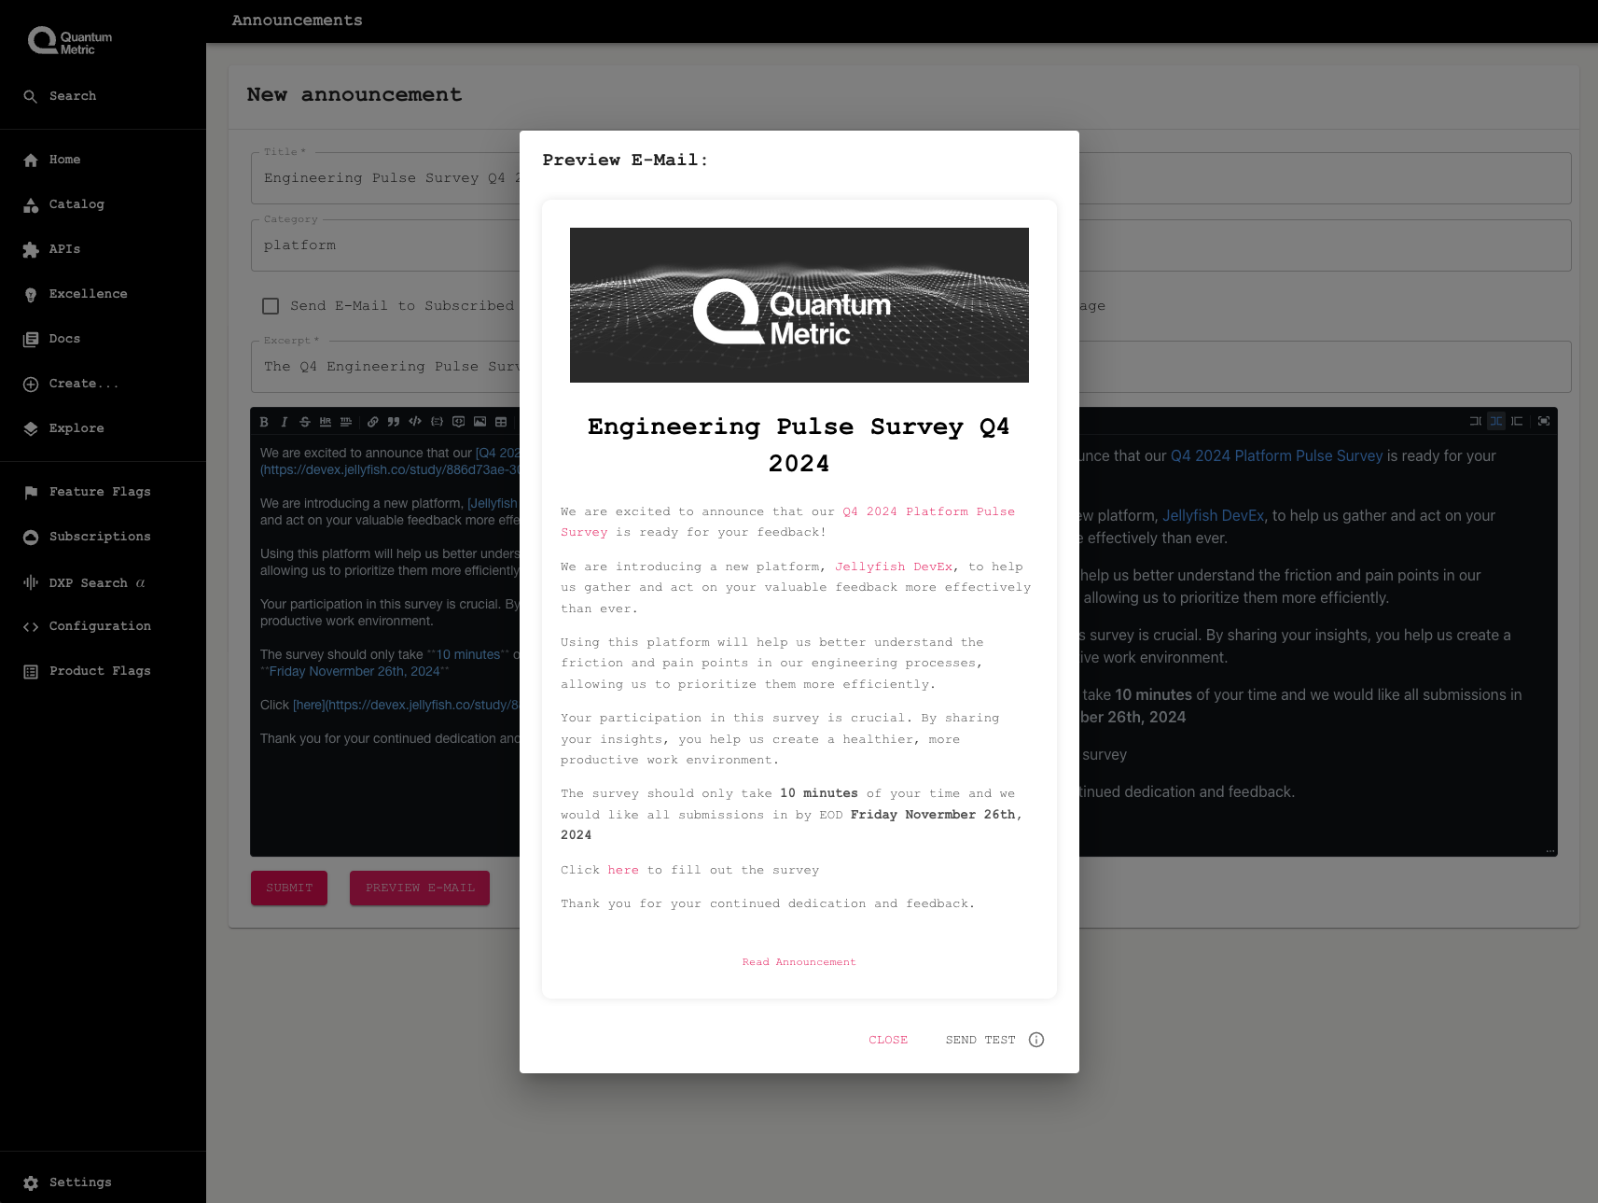
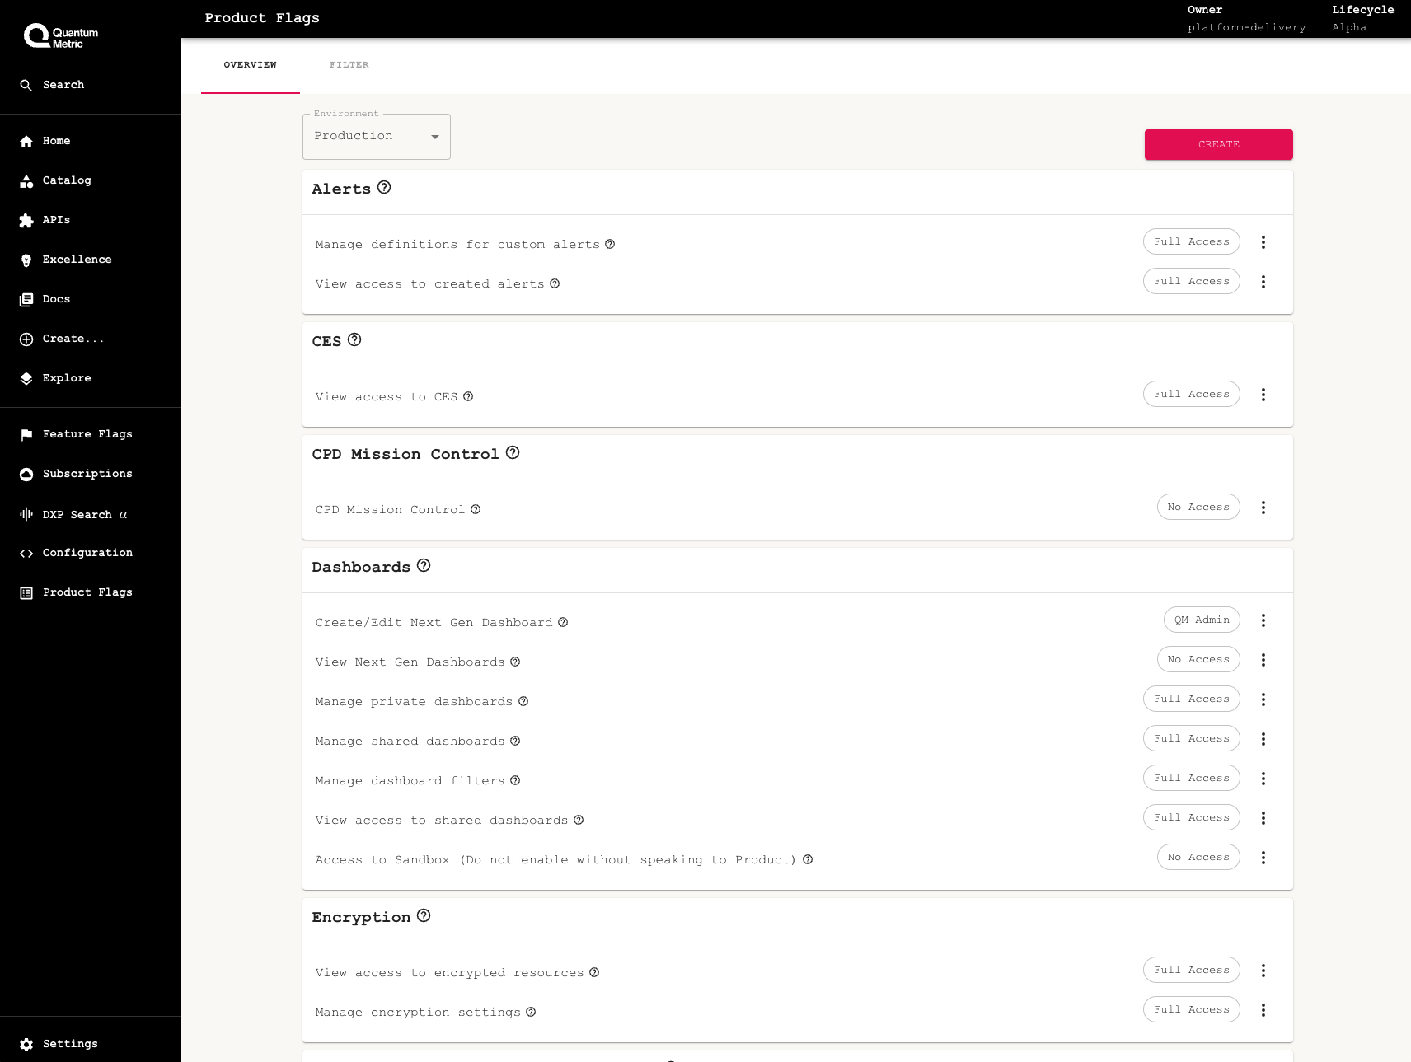
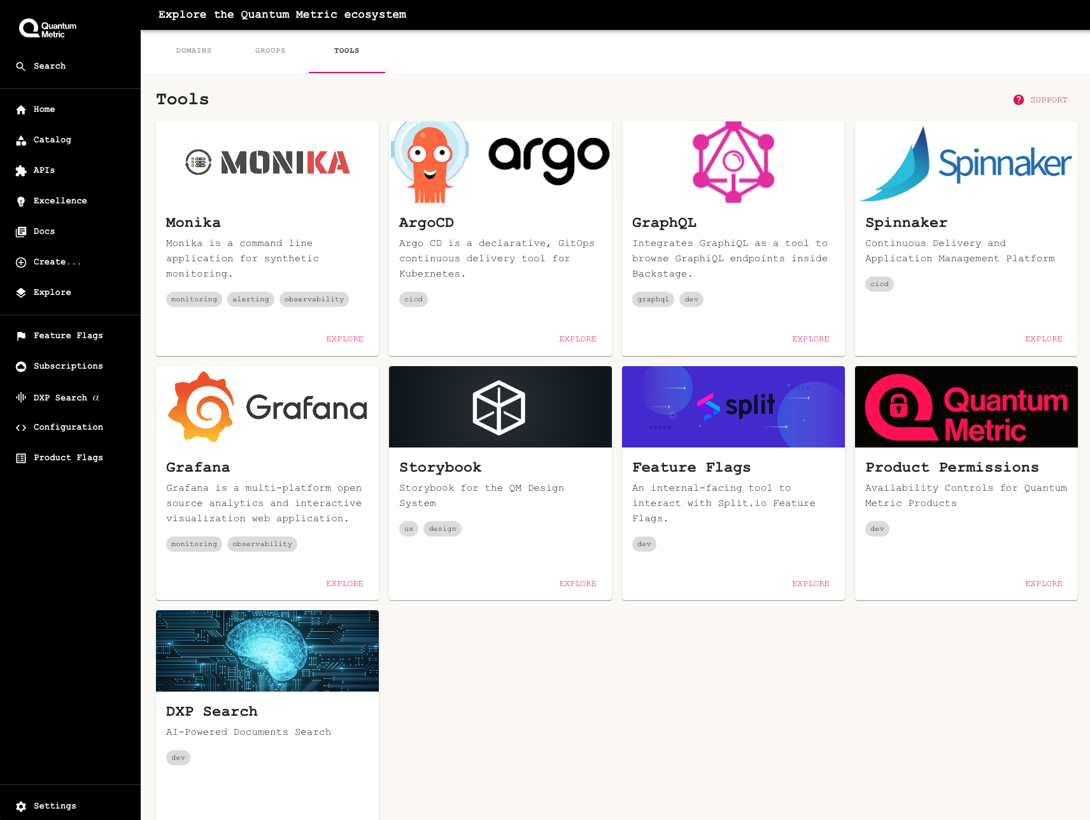
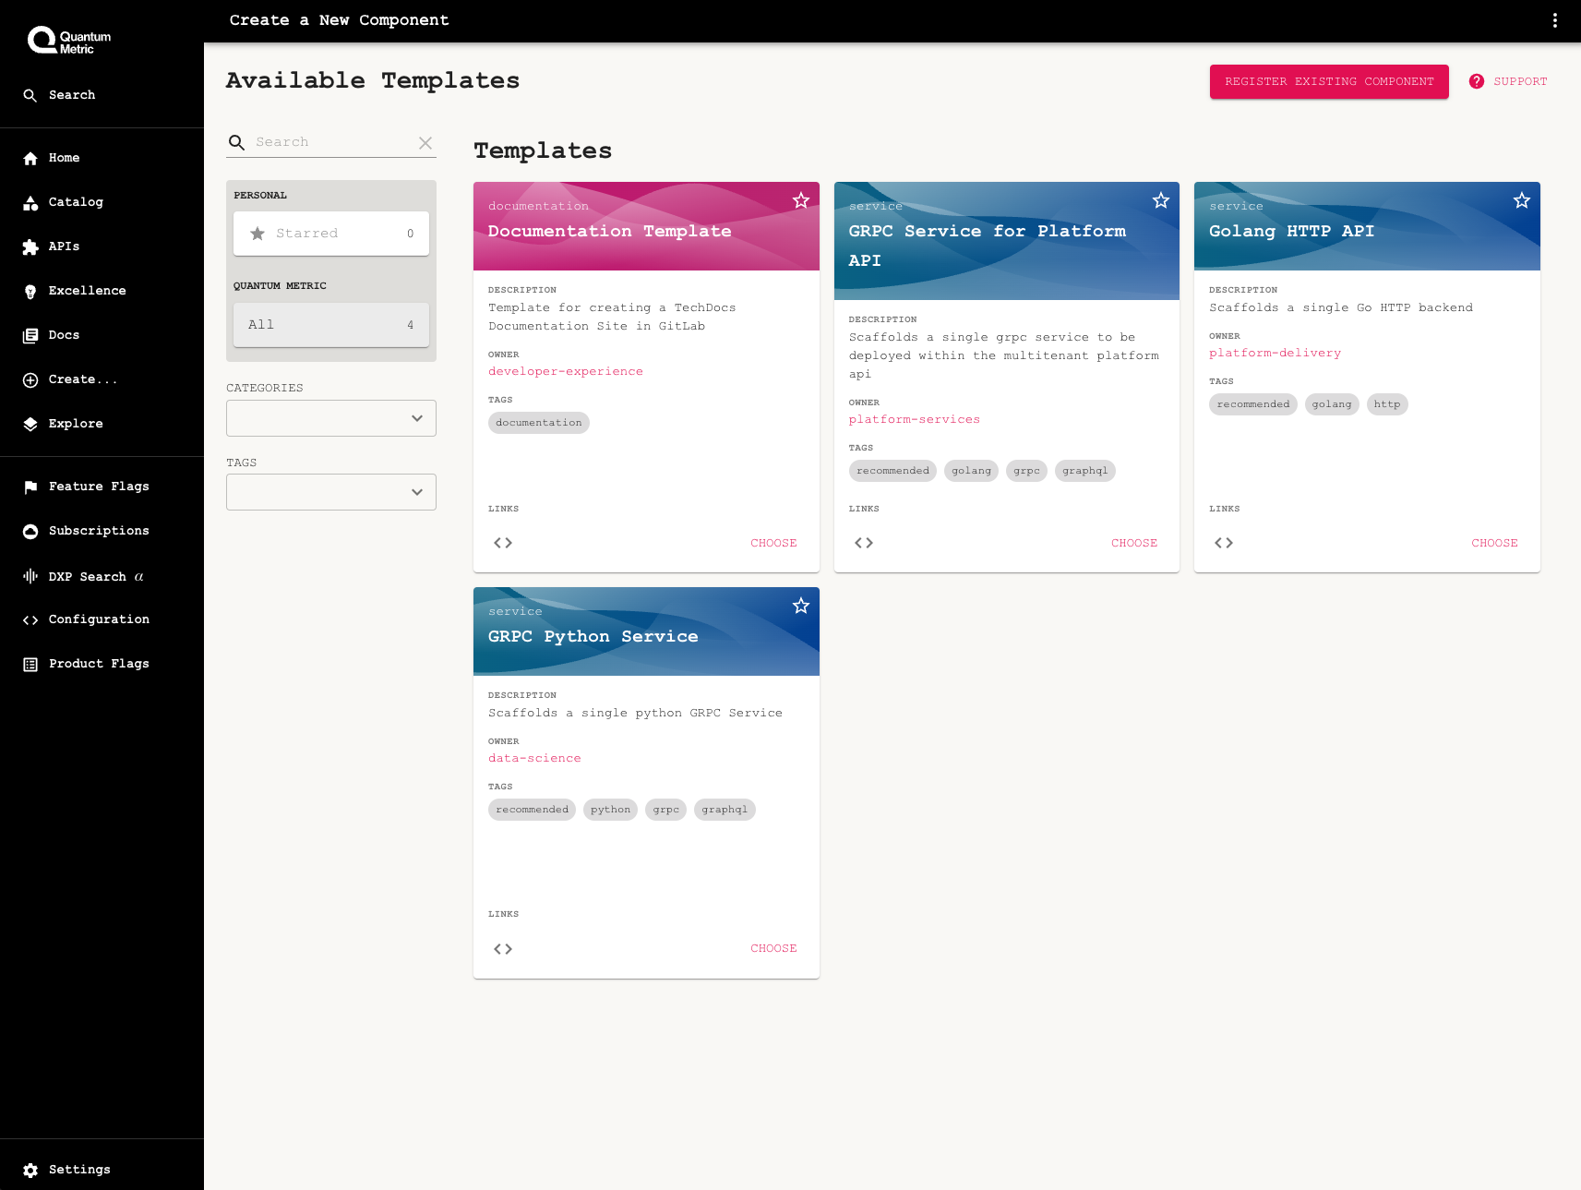
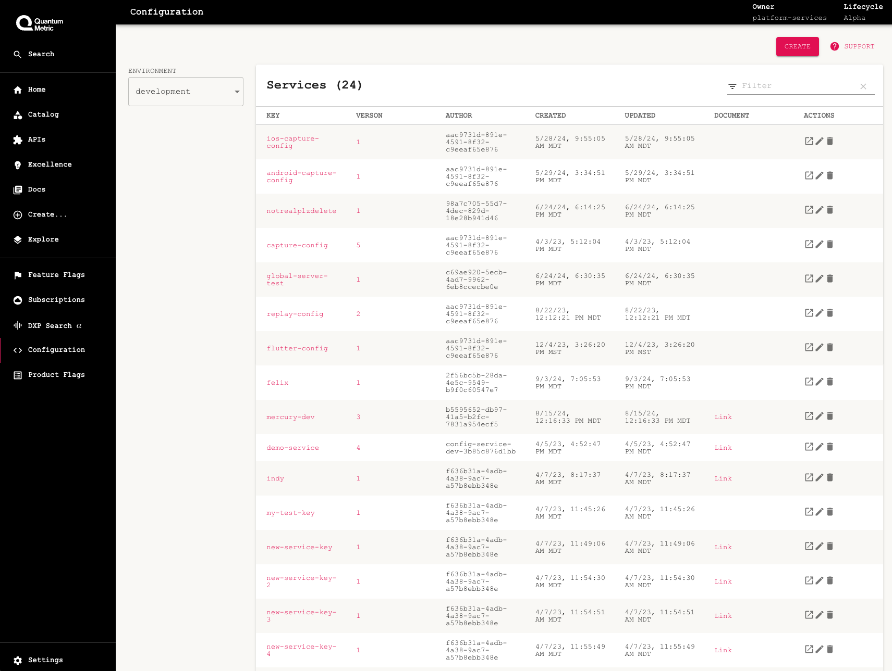
The Platform “Flywheel” Effect
Building more features led to lower time and effort to recognize value
AI Search
Announcements
Product Permissions
Tool Discovery
Templating
Configuration

Slide 19
Key Themes and Takeaways

Slide 20
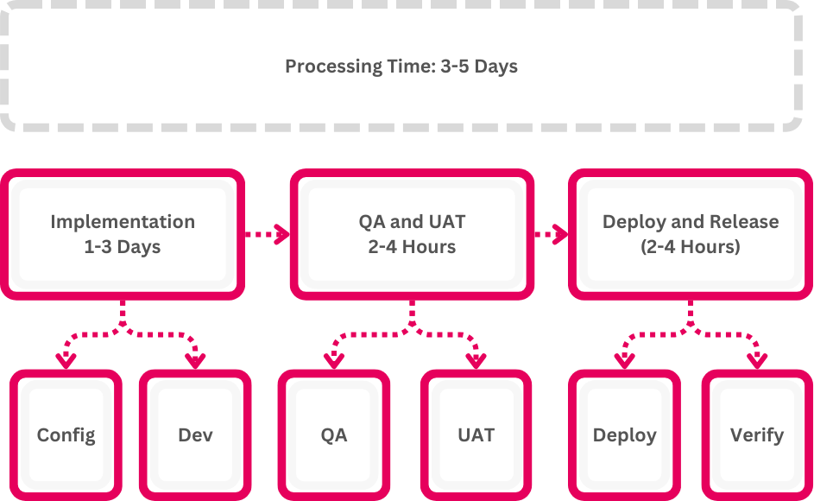
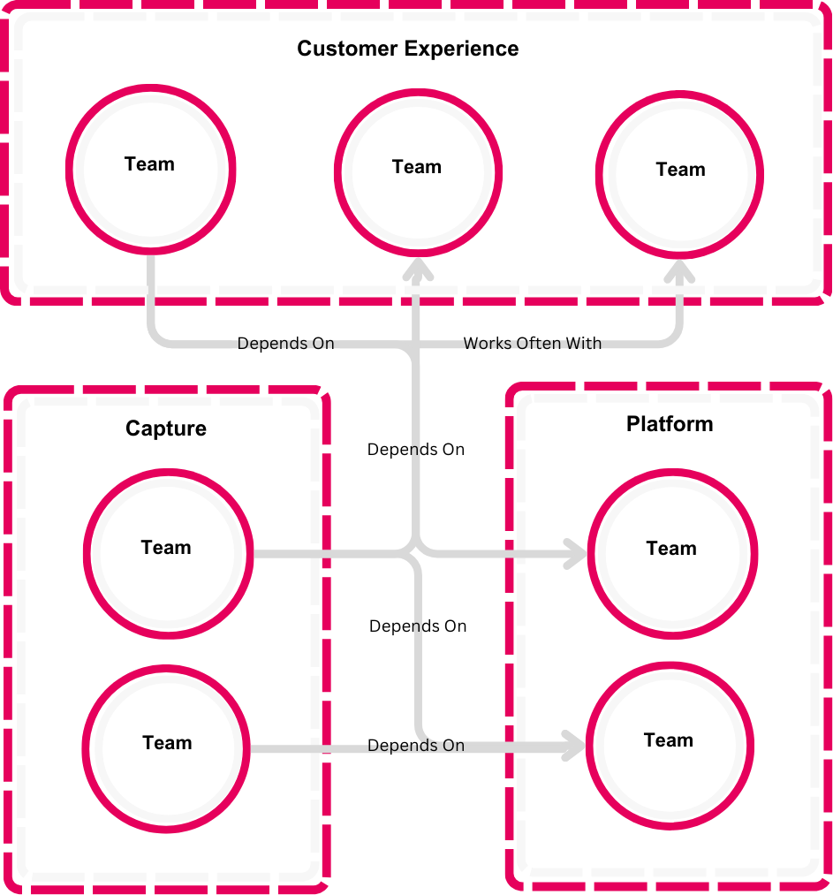
Know Your Value Stream
Invest time to understand how value is created, the domains your teams operate in and how they interact

Slide 21
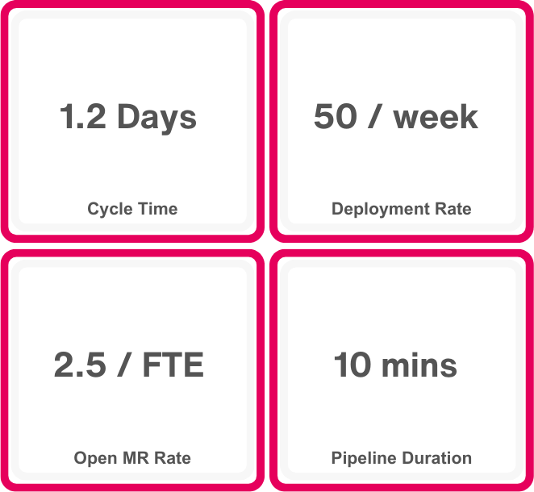
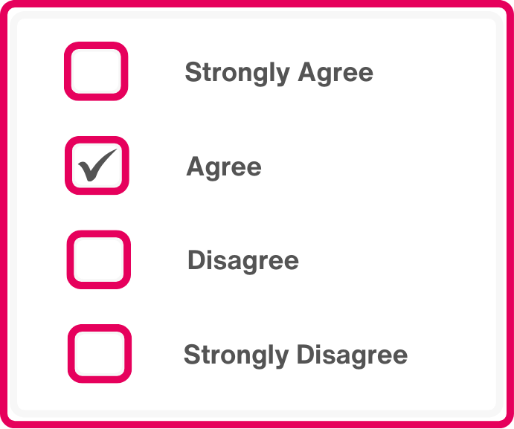
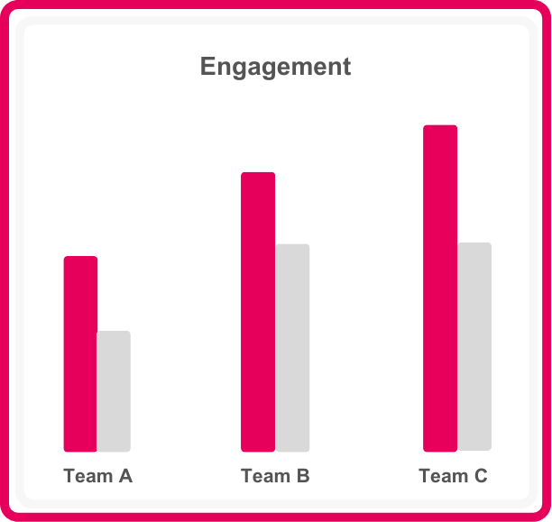
Get The Most Out of Your Data
Utilizing different data points helps you make informed decisions rooted in reality.
Engineering Metrics
Pulse Surveys
Platform Analytics
Focused on Flow and Process
Direct Qualitative and Quantitative Feedback
Tracks Usage, Engagement and User Behaviors

Slide 22
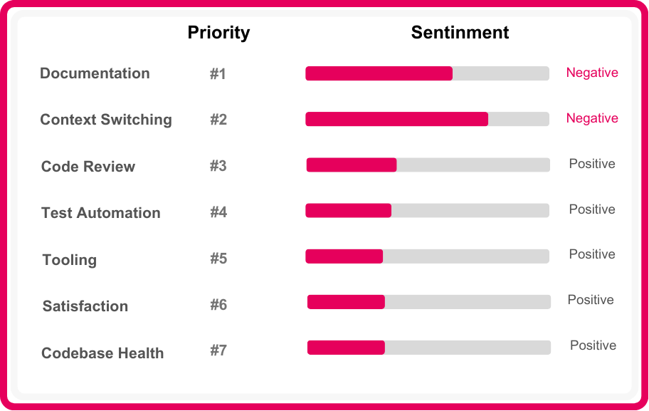
Decoupling Sentiment From Priority
Clear opportunities emerge when sentiment is decoupled from priority

Slide 23
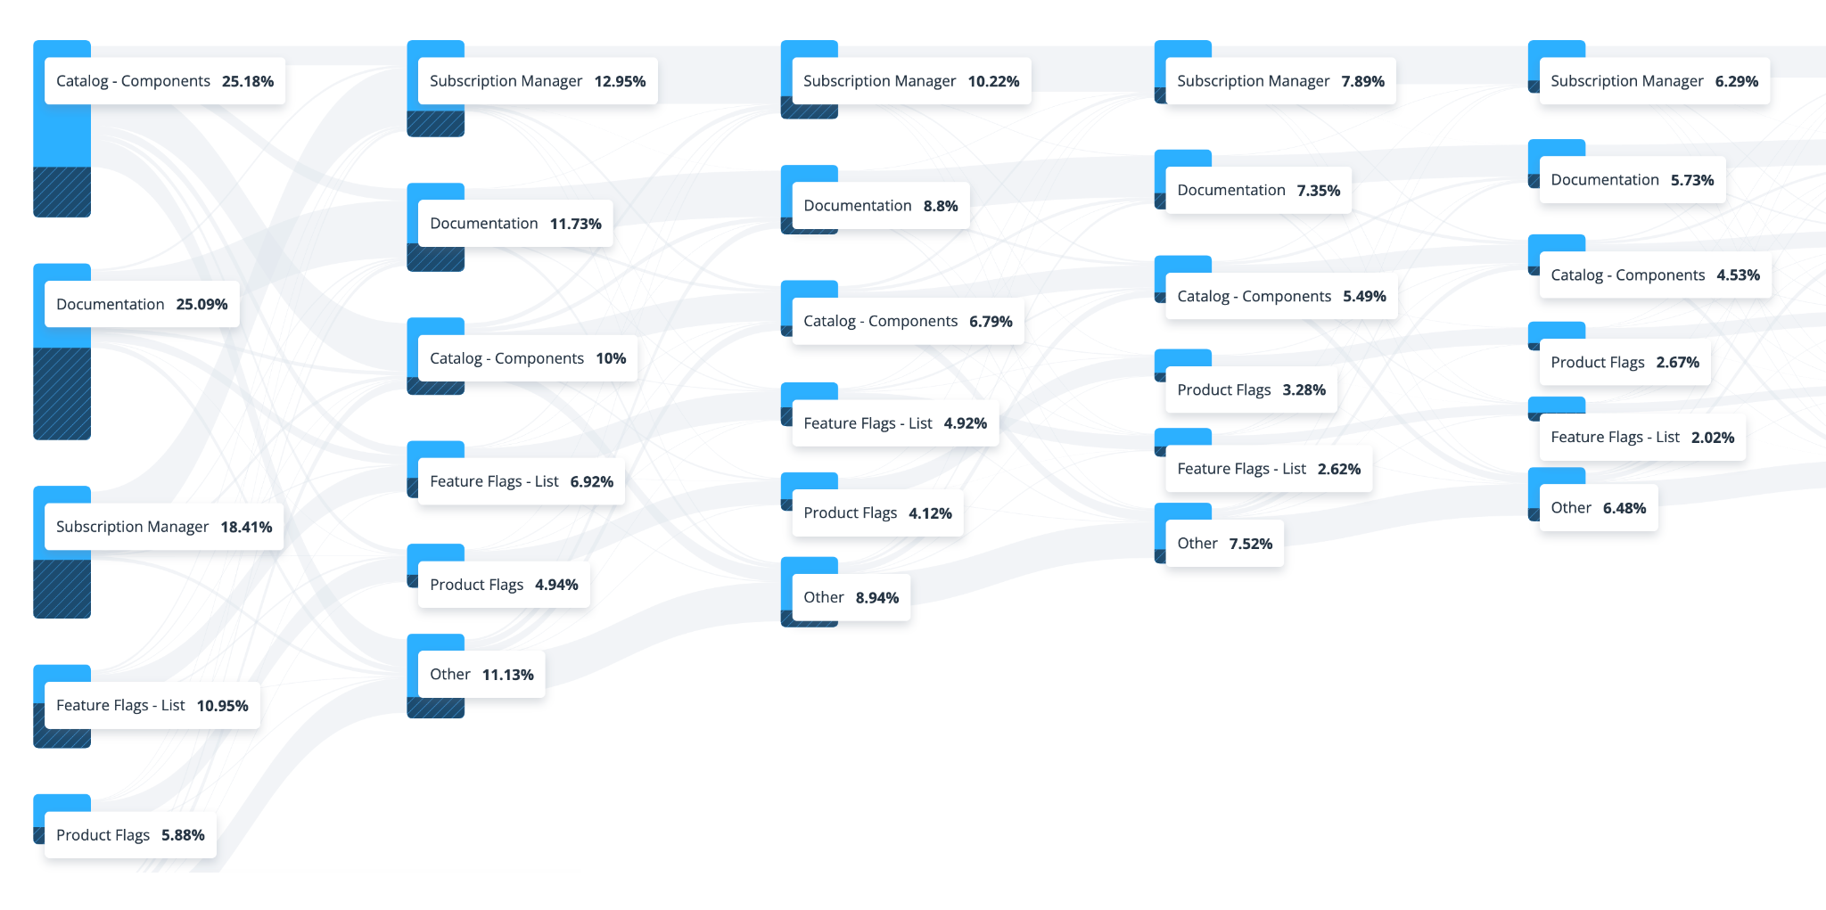
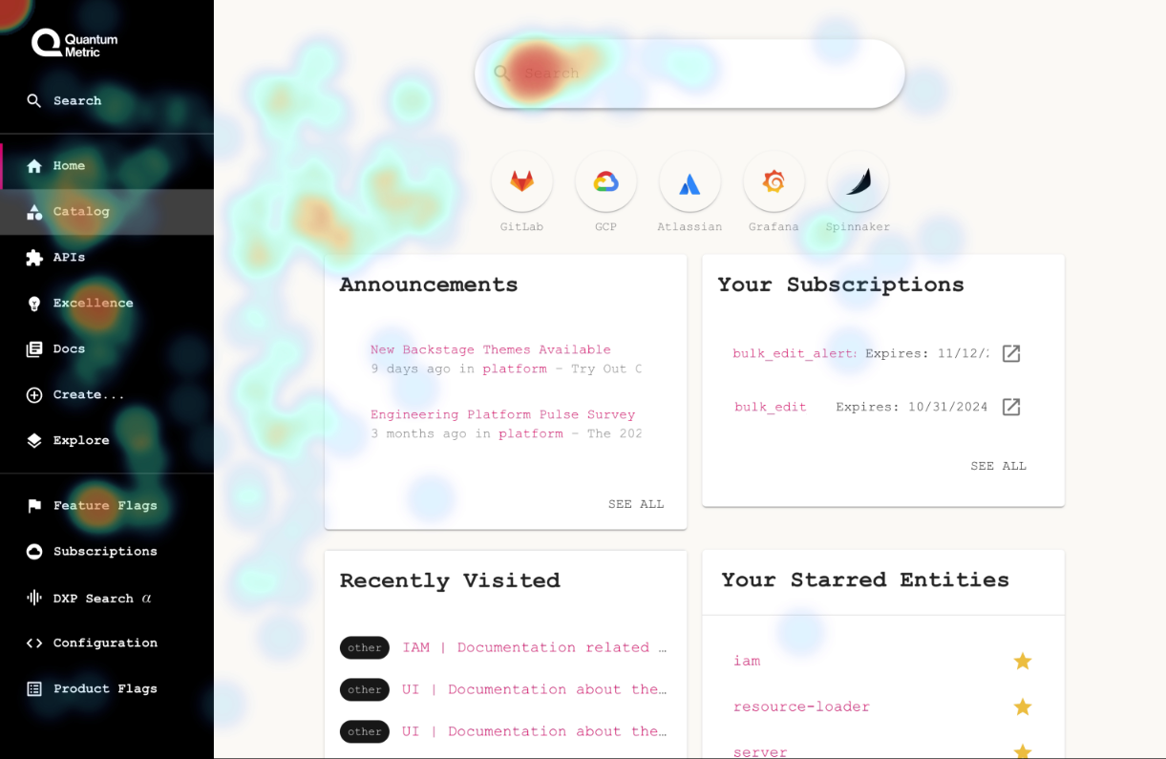
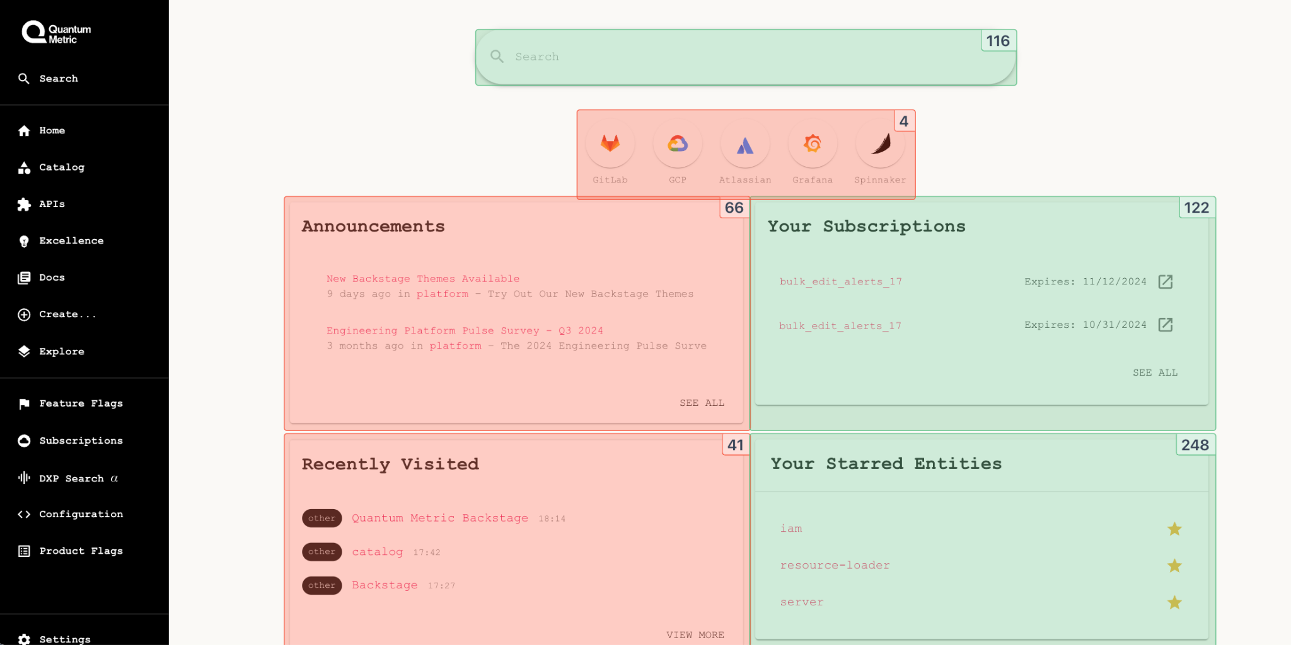
Understand User Flow and Engagement
Identify and improve key interaction points by understanding user flow and engagement
User Journey Analysis
User Engagement
User Interactions
“What paths are users taking through our platform?”
“How is the user engaging with this feature?”
“Where are users interacting with most? Least?”

Slide 24
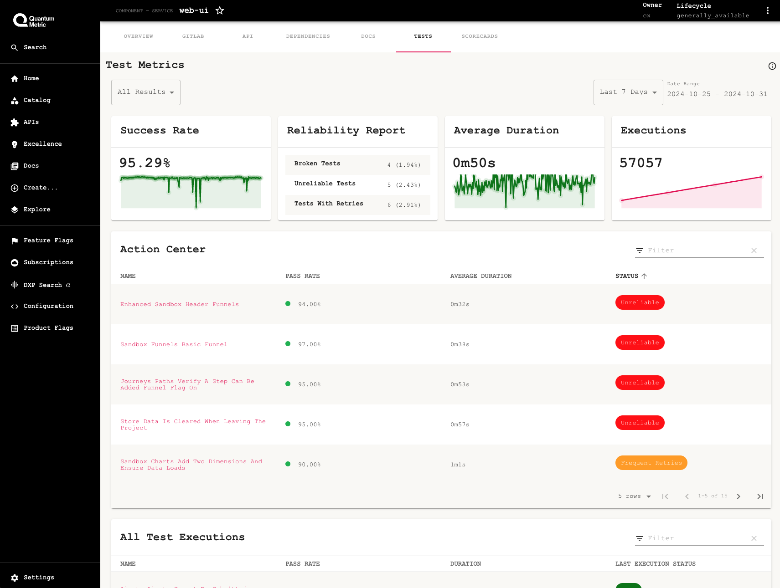
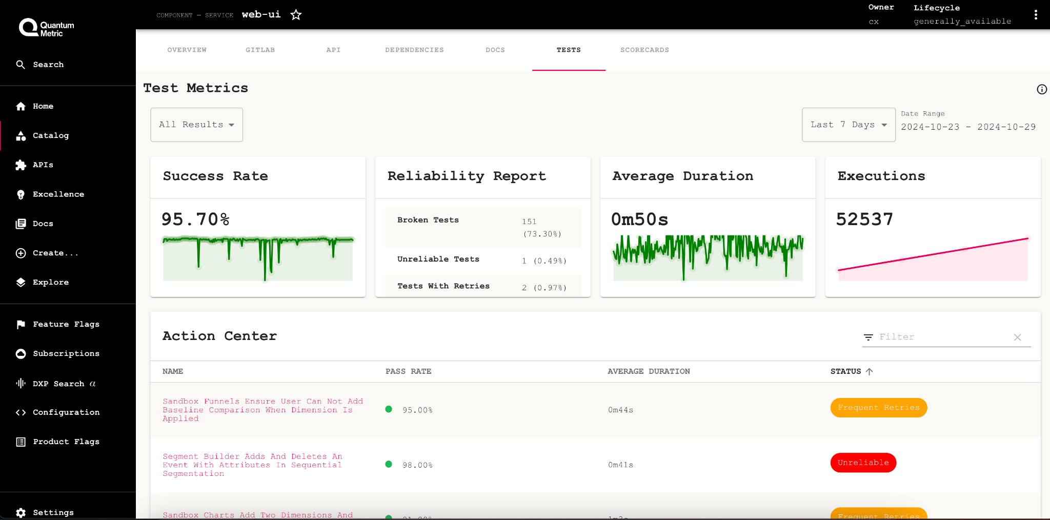
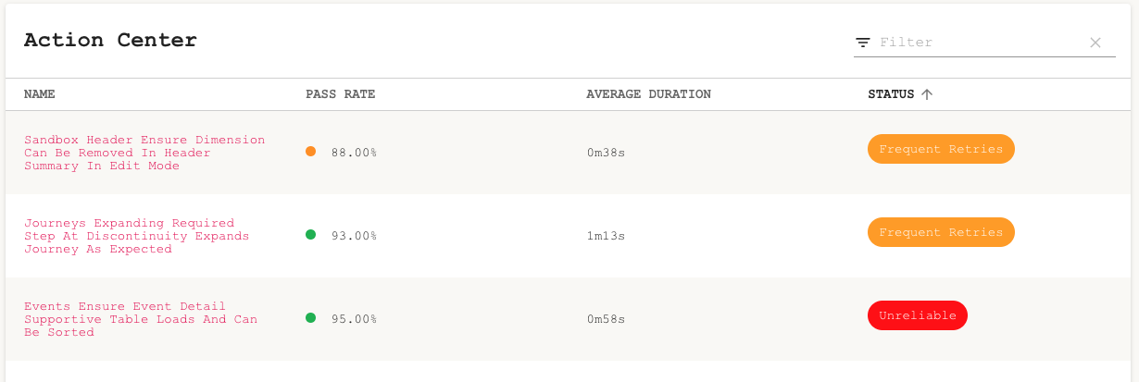
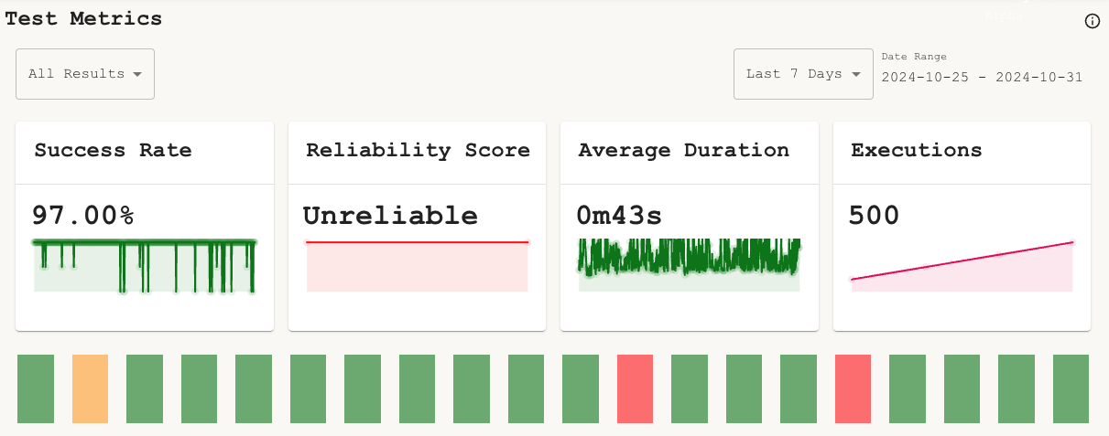
Make Data Visible
Visible data leads to decisive action and drives meaningful change
Actionable Insights
Trend Monitoring

Slide 25

Trust the Process and Close the Loop
The path to recognizing value isn’t a one-size-fits-all journey

Slide 26

Questions and Feedback
linkedin.com/in/ericirwin1124
Eric Irwin
eric.irwin1124@gmail.com
Sr. Director of Engineering Quantum Metric

